Slide 1
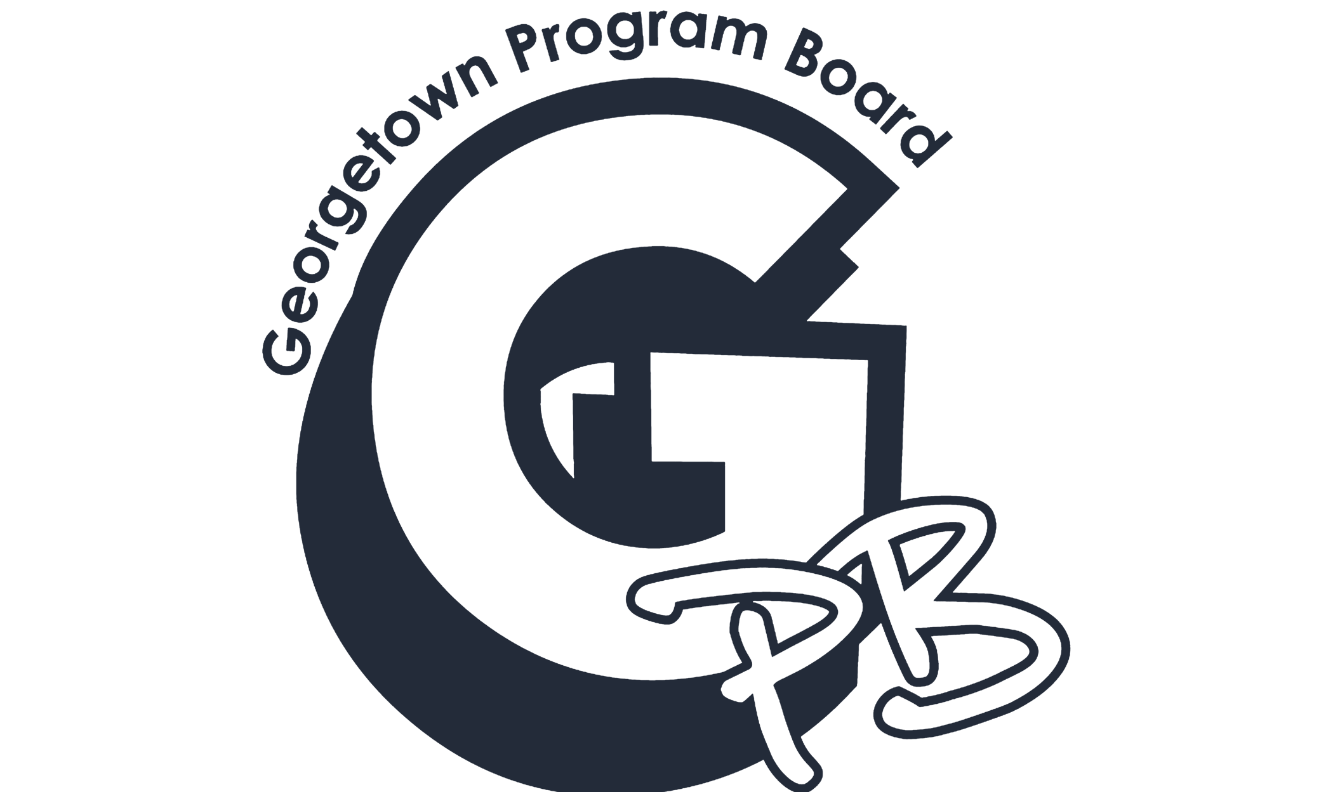
Georgetown Program Board FY 20 FinApp Presentation

Slide 2
What’s GPB?
The mission of GPB is to foster community spirit at Georgetown by providing high-quality, low-cost entertainment open to the entire undergraduate student body. We also collaborate with other student organizations to produce programs that reflect the mission of GPB and the diversity of interests, backgrounds and persons at Georgetown University.
Notes:
Hunter:

Slide 3
What does GPB do?
Weekly Movie Showings
Round tables discussions on movies
Mr. Georgetown
GPBrrrrFest (Ice Skating and Winter Festival in Red Square)
Oscars Watch Party
Spring Kickoff Concert
Build-A-Bulldog
Boat Party
Funniest Human @ Georgetown
Super Bowl Watch Party
Hoya Hub Cooking Class
Rocky Horror Picture Show
Georgetown Day
Halloweek
Haunted Healy
NSO Night Event
Cafe GPB
Springfest
Class Cab Rides
Petting Zoo
GPBowling
Anti-Valentine’s Day
Pre-Concert Bash
Glow Party
Late Skate
Sundae Sundays
Notes:
Hunter: highlights range of events, might have not known they were GPB, most traditions on campus are GPB

Slide 4
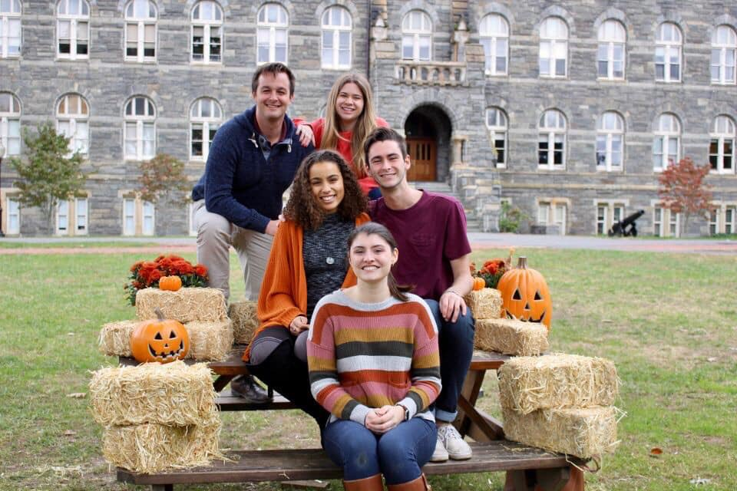
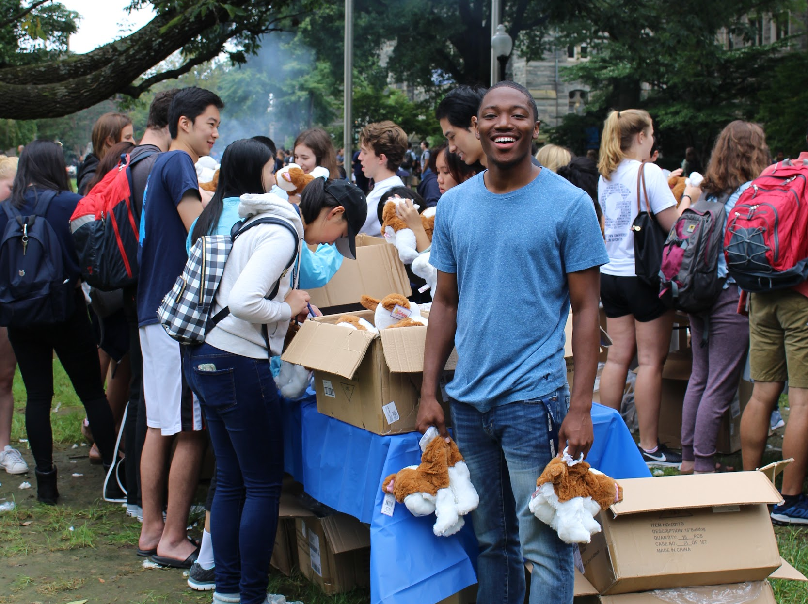
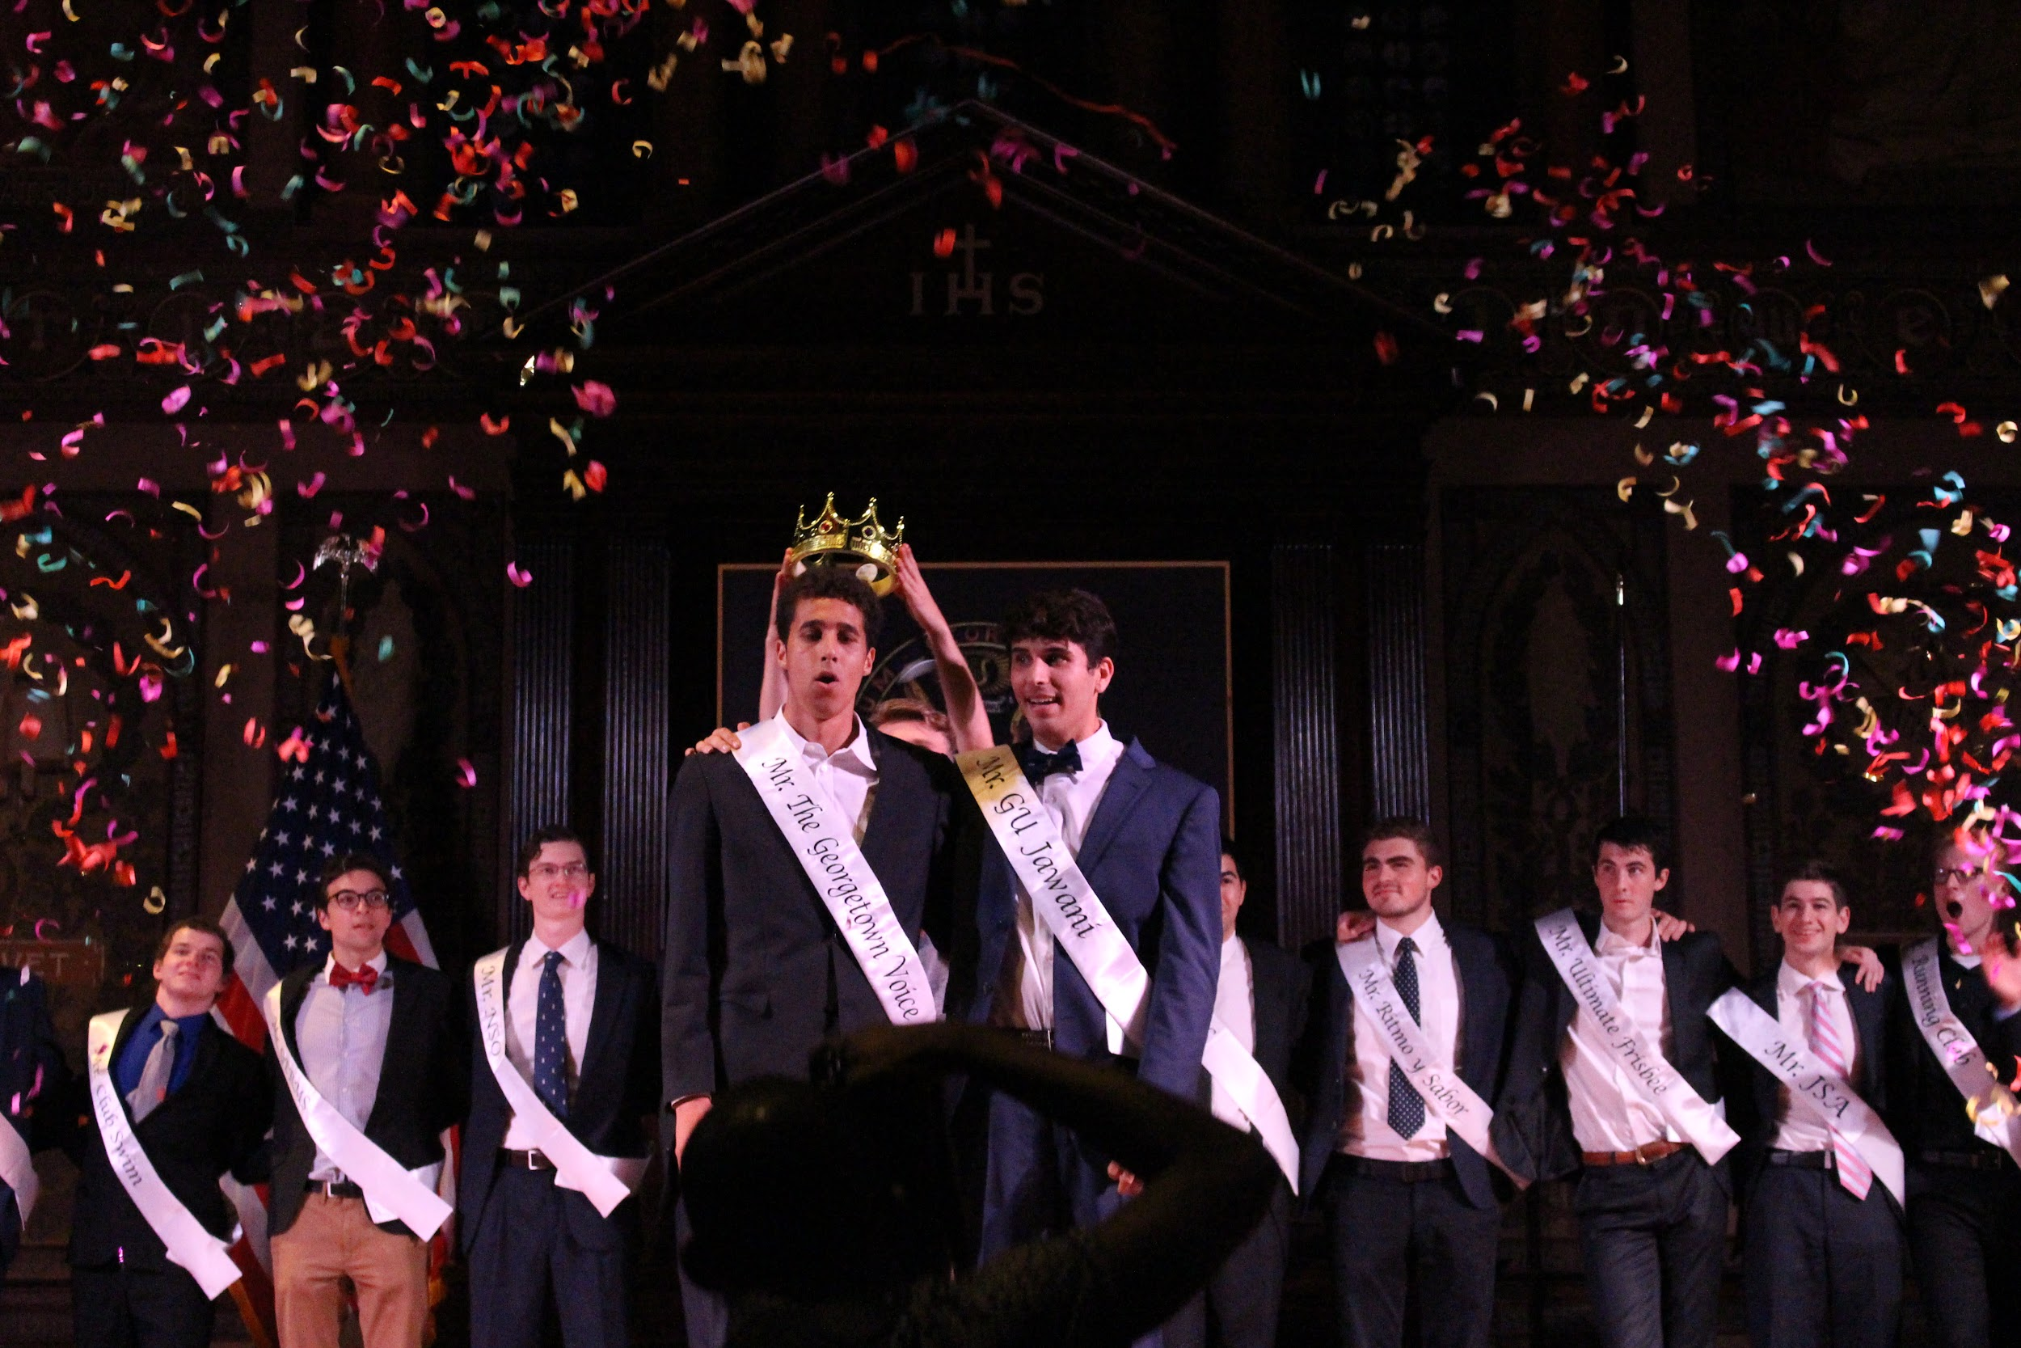
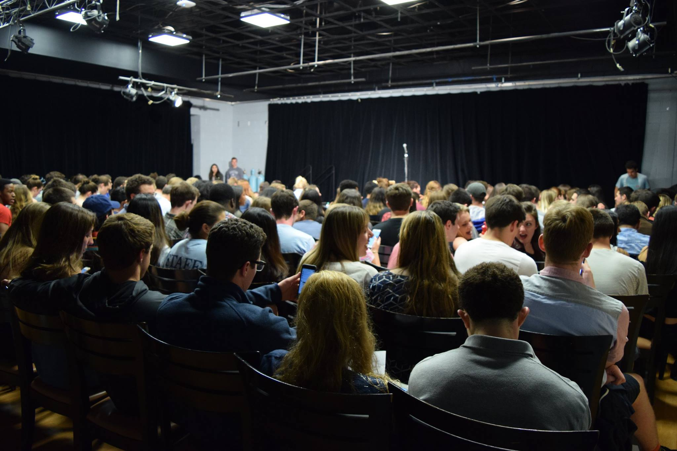
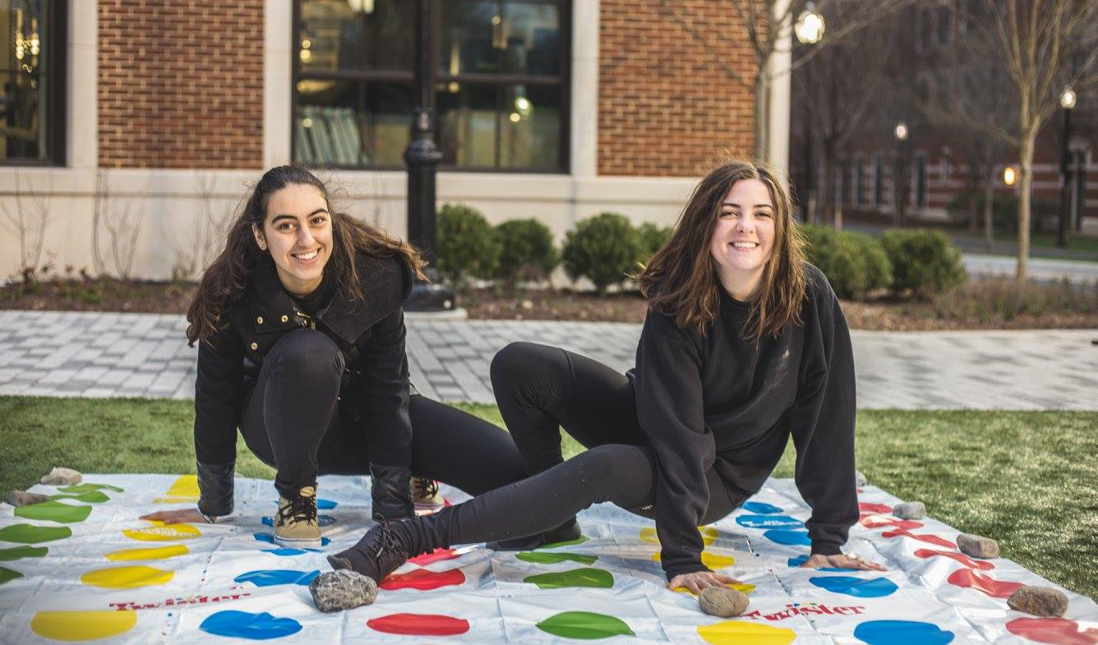
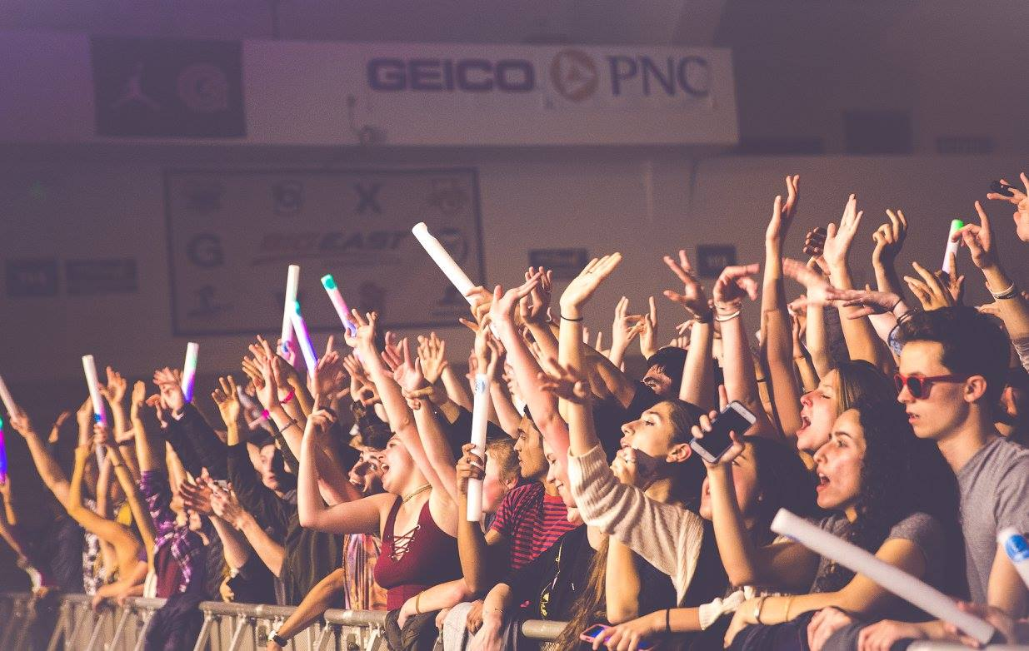
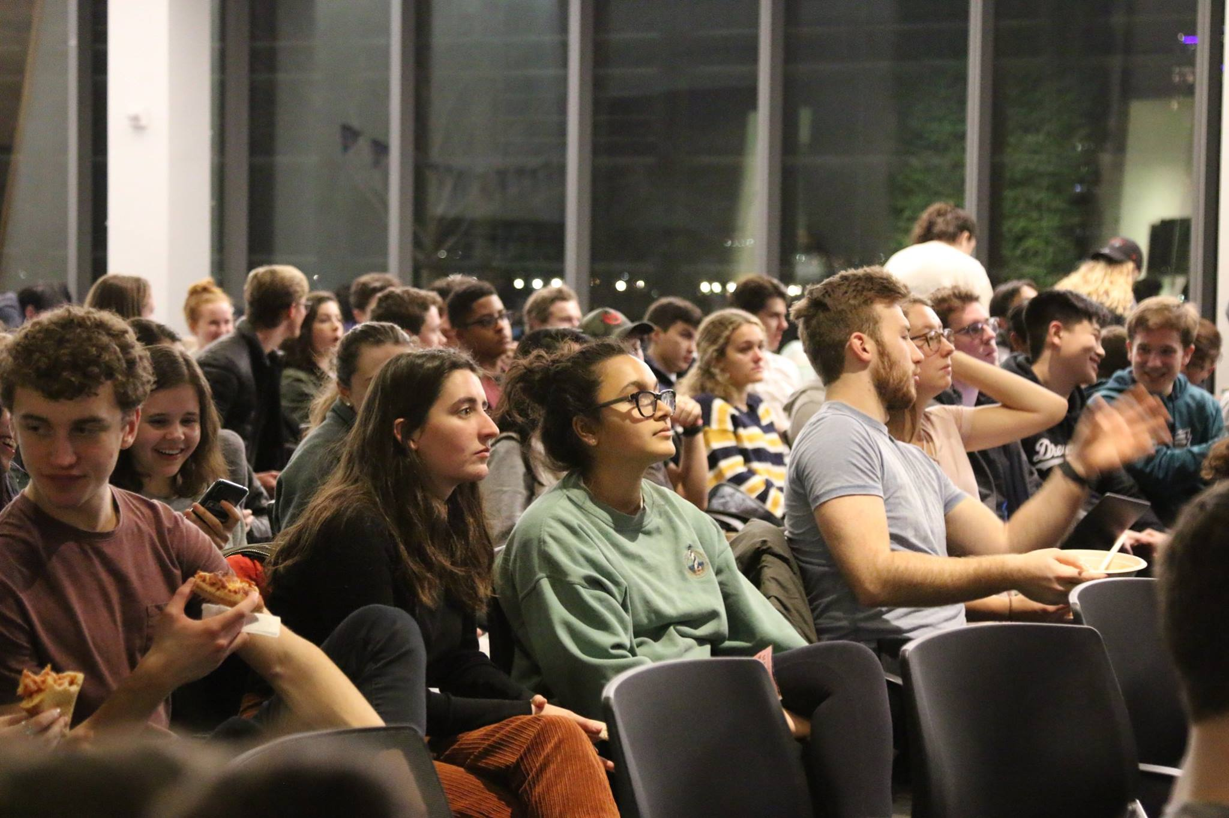
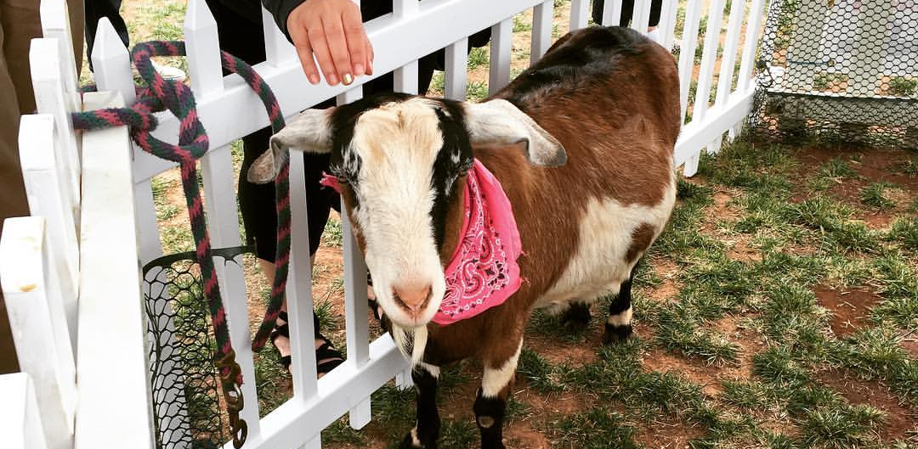

Notes:
Hunter

Slide 5
Why GPB?
GPB brings a unique value proposition to campus
The only organization that is responsible for consistent, entertaining programming that is open to the whole campus.
Money invested in GPB is directly invested in the student experience.
There is demonstrated need for increased funding for GPB and its mission
Notes:
Ava

Slide 6
Who does GPB Impact?
In the past year, we have had approximately 15,000 Georgetown attendees at our events
With an undergraduate population of approximately 6,700, there was a clear and evident opportunity for every student to engage with GPB at any point
Through strategic marketing campaigns across all social media platforms, engaging students with consistent tabling, and spreading awareness through ubiquitous flyering, we have worked to impact each Hoya on campus!
Notes:
Ava: added another marketing chair

Slide 7
Inclusivity Initiatives
In order to ensure we are working towards reaching every student on campus, we have taken the following steps:
Maintained partnership with GSP to provide free, first-priority tickets for GSP students to all paid ticketed events.
Engaging in approximately 60 GPB-lead co-sponsorships, with organizations such as
QPOC
Women’s Center
NSO
WGTB
1634 Society
The Corp
BRAVE
Guerilla Improv
BSA
Caribbean Culture Circle
LGBTQ Resource Center
Asian Pacific Islander Leadership Forum
The Georgetown Heckler
Center for Social Justice
Hoya Hub
Interhall
Notes:
Ava: recognize that some student are not able to go home. we put a few here willing to talk about what we did in the questions portion (films, late skate offcampus, cafe gpb funniest human arts events, hoya hub cooking lesson, build a bulldog traditions day)

Slide 8
Invest in the Student Experience
As a budgetary practice, GPB does not spend more than 1-2% of its total allocation on its own membership—different than other applicants
Even though GPB’s membership, of over 100 students, is completely open, with no app required
Increases in our allocation would go towards
Revamping Institutional Georgetown Day Programming
Build on Success of Film Expansion
Broadening the Reach of the Concert
FY19 “General Events” funding is appropriate to continue into next year
Continuing to expand our general members’ abilities to program for the entire student body
Notes:
Ava: many other schools programming is a paid role. took time to see how we could improve recognize where the money is need

Slide 9
Why Georgetown Needs GPB
GPB is the only organization whose variety of programs are intended to appeal to the WHOLE student body
Without an on-campus sports culture like many of our peer institutions, we need events to bring together all students and form community
GPB appreciates the diversity of people at Georgetown and creates memorable experiences for all its students to be engage in, connect to, and be proud to be a Hoya
Notes:
Hunter

Slide 10
The How

Slide 11
Executive Board
Composition
With the additional funding received in FY19, GPB continued to see an increase in demand for large scale programming; however, noticed a need for additional human capital to execute the programs
Current Structure
President
Vice President
Finance Chair
2 x Concerts Chairs
Georgetown Day Chair
Films Chair
Marketing Chair
4 x Events Chairs
Expanded Structure
President
Vice President
Finance Chair
2 x Concerts Chairs
Georgetown Day Chair
Films Chair
2 x Marketing Chair
5 x Events Chairs
Notes:
Talk about constitutional review, and the intentionality of our reflection on our structure, drawn ourselves out
Also these 14 positions create more opportunities for Georgetown students to learn transferable leadership skills AND supports our goal of expanding our capacity to provide programs

Slide 12
Budget Breakdown
Current Budget
Concerts | $84,601.00
Films | $37,235.00
Marketing | $4,000.00
Georgetown Day | $12,000.00
Event Chairs | $52,400.00
Operations | $3,500.00
FY19 Budget | $193,576.00
Projected Expenses
Concerts | $91,836.00
Films | $40,000.00
Marketing | $4,000.00
Georgetown Day | $15,500.00
Event Chairs | $52,400.00
Operations | $3,500.00
FY20 Projections | $207,076.00
Notes:
grants coca cola grant and activities allocations

Slide 13
Total Ask:
$148,500.00

Slide 14
Demonstrated Need
Concert
Georgetown Day budget increase
Films
Notes:
Huner

Slide 15
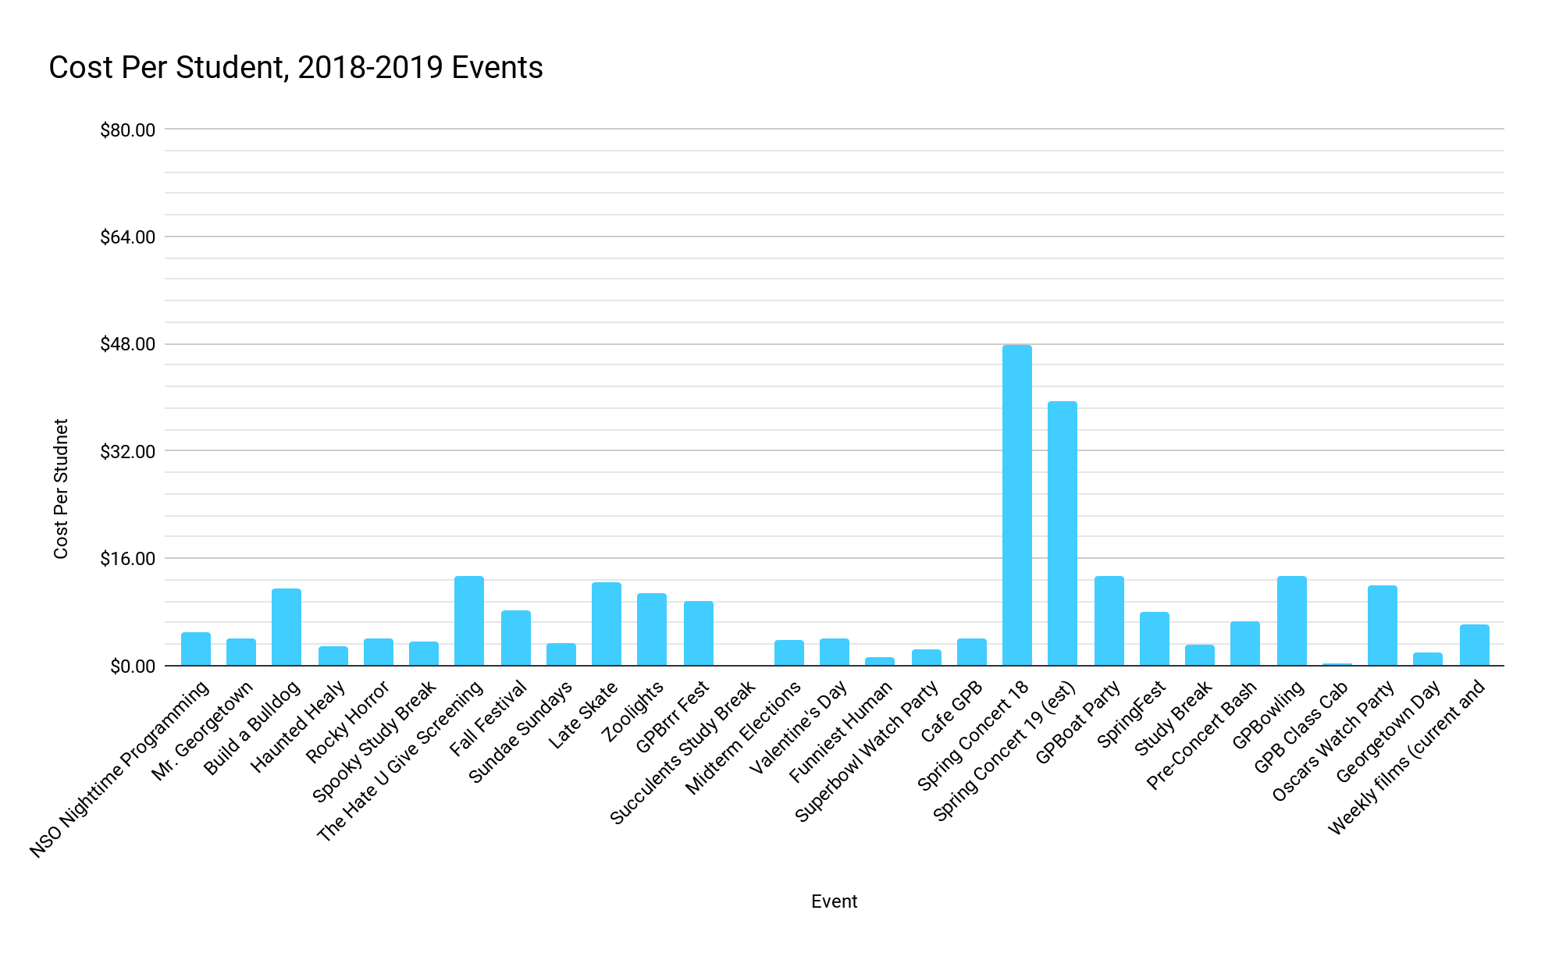
Notes:
Ava and Hunter cost per head is a few dollars some very little, the arrowed events were off campus

Slide 16
Managing Cost Per Student
Hearing FinApp feedback from last year, only 1--instead of 4--is more than $25/student
4 out of 5 events that cost over $10/student were off campus event
The concert, the event that is over $25/person, is our most important capstone event
Notes:
Hunter: gpb took the suggestions FinApp have given them and improved

Slide 17
Why have the concert?
The concert is the largest student run event on campus
Increases awareness of the organization to the whole student body in order to enable us to reach EVERY student for each event
Peer institutions have similar events
Our concert costs approximately $25/student to produce, but our goal is to never charge any more than $10 for General Admission tickets.
Average concerts tickets in the DC Area are $30-60
Free tickets are offered to GSP students
Notes:
keystone event brings alot of memebers
alot of a followionig
diverse generla body
they create other event throughout the year
create community
prvelent on college campusses
unique if gtown didtn have concert
gtown doesnt have good psorts event smost chance of having different backgrounds )grades chools
proud to be a hoya

Slide 18
Conclusion
Every dollar you invest in GPB is a dollar directly invested in the Georgetown Undergraduate Student experience.

Slide 19
Questions?

